Slide 1
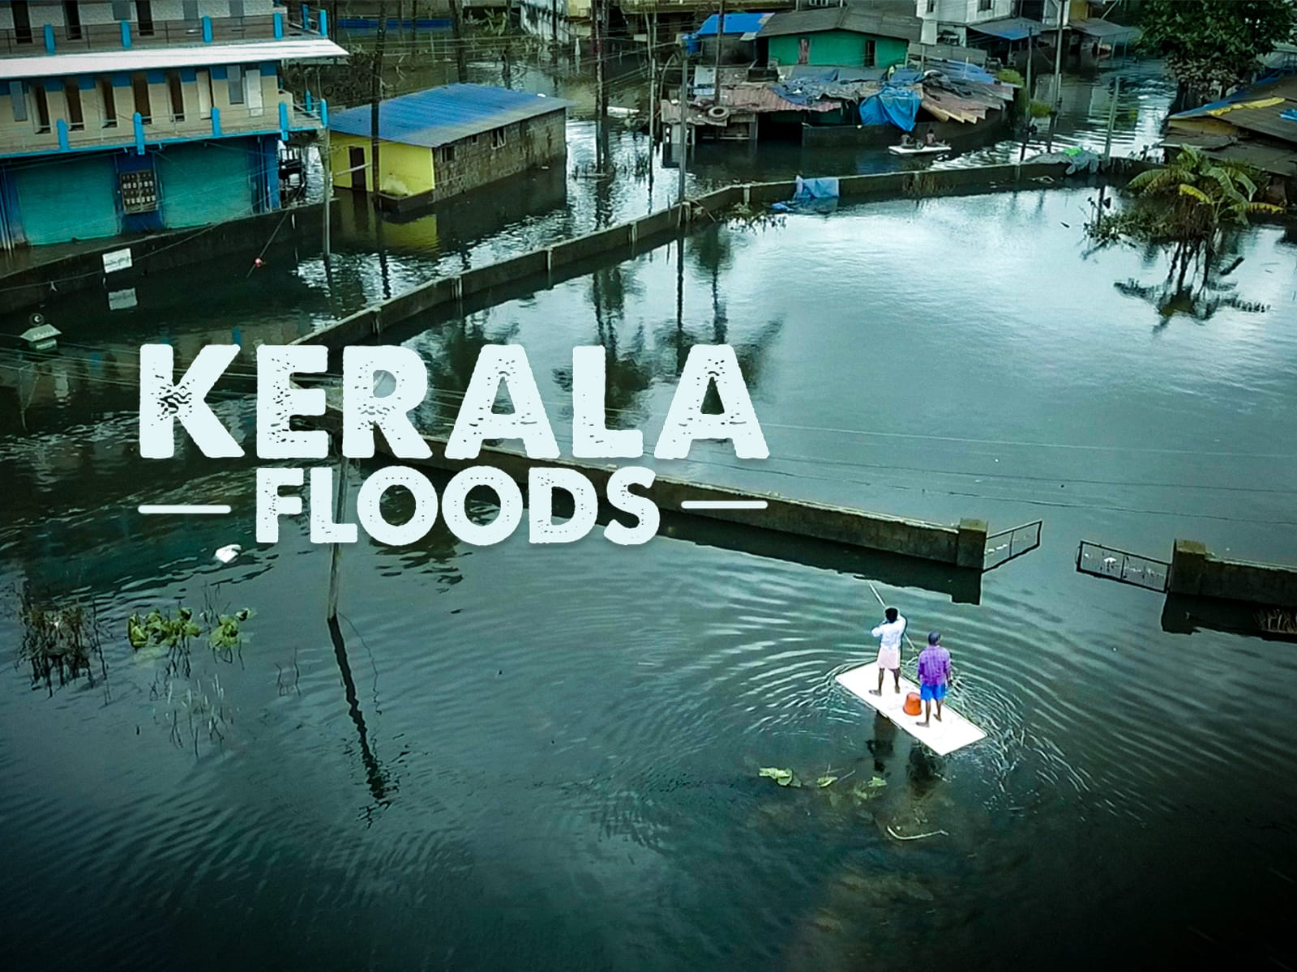

Slide 2
INTRODUCTION
The Kerala floods of 2018 were one of the most devastating disasters in the state's history, triggered by excessive monsoon rainfall. All 14 districts were affected, with the worst-hit areas being Idukki, Wayanad, Alappuzha, and Ernakulam. The state received 116% more rainfall than usual, causing major rivers like Periyar and Pampa to overflow, leading to widespread flooding. The floods impacted over 5.4 million people, making it Kerala’s worst flood in nearly a century. The disaster claimed over 483 lives, displaced more than 1.4 million people, and caused an estimated ₹40,000 crore ($5.8 billion) in economic losses, severely damaging homes and infrastructure.

Slide 3
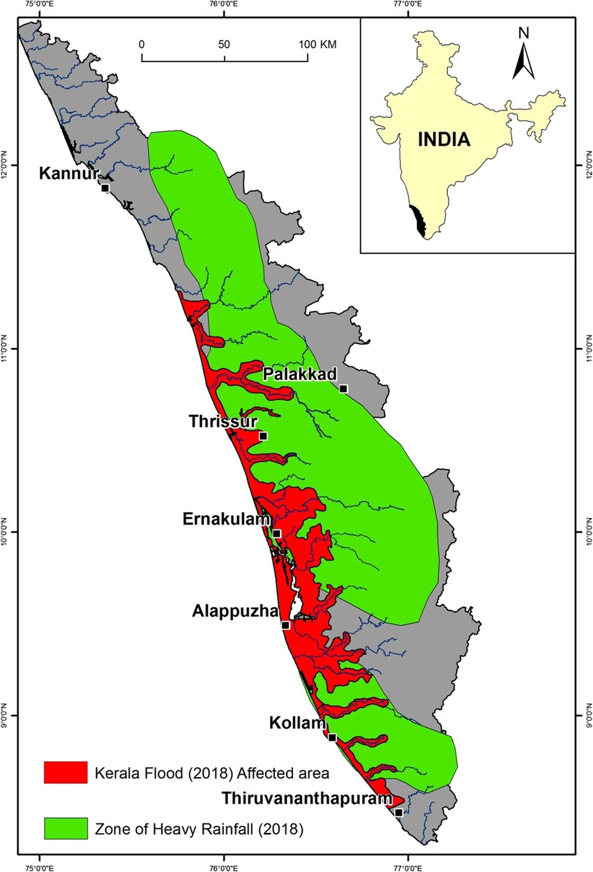
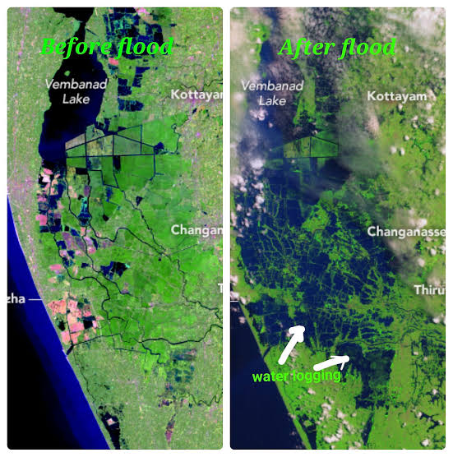
GEOGRAPHICAL VIEW

Slide 4
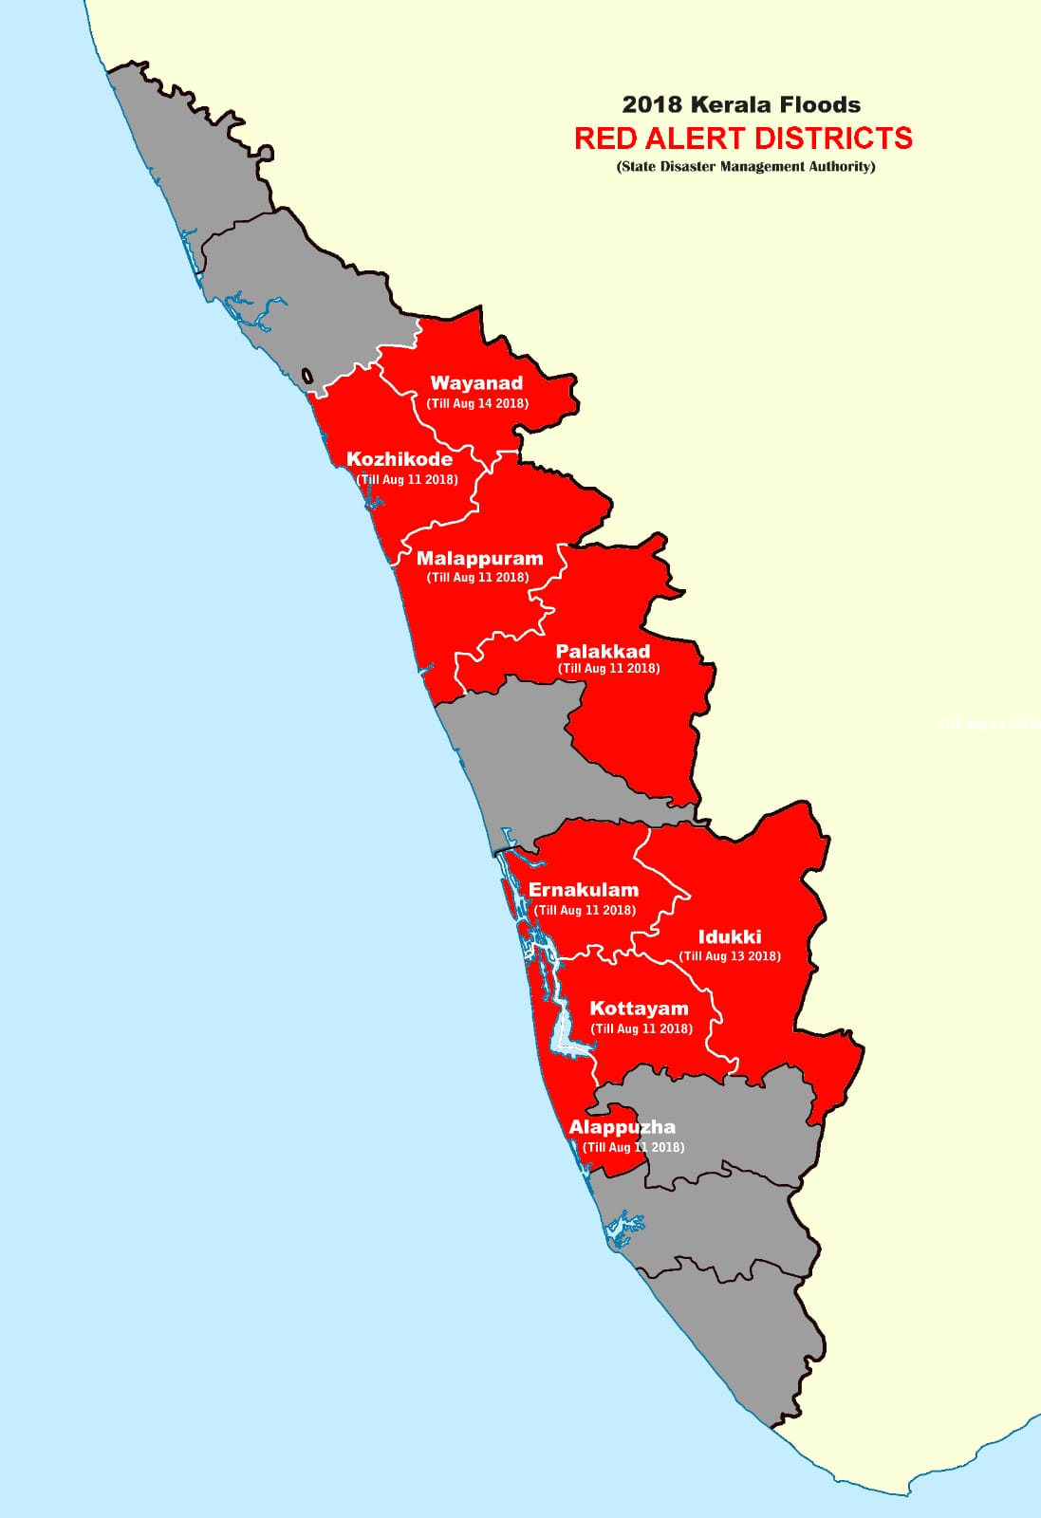
TIME LINE OF FLOODS
August 8-15
Heavy rainfall and landslides triggered widespread flooding across Kerala.
August 16-20
The situation worsened as more dams were forced to release water due to high reservoir levels.
August 21-29
The floods began to recede, but the aftermath was devastating, with widespread damage and displacement.

Slide 5
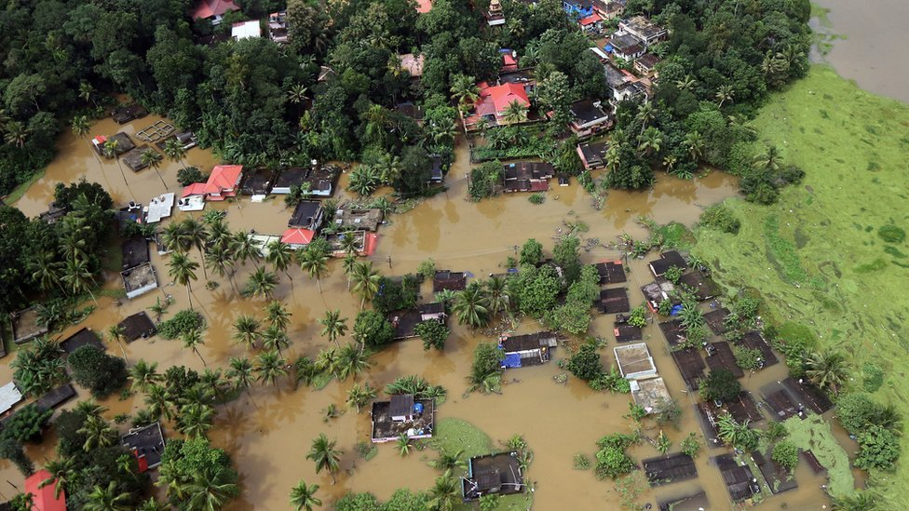
CAUSES OF FLOODS(Natural)
Monsoon Rainfall
The 2018 monsoon season witnessed record-breaking rainfall, exceeding the average by several times.
Dam Releases
Dams were forced to release excess water, contributing to the flooding of downstream areas.
Landslides
Heavy rainfall triggered landslides, blocking roads and exacerbating the flood situation.

Slide 6
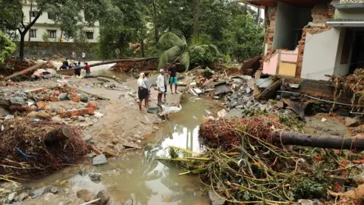
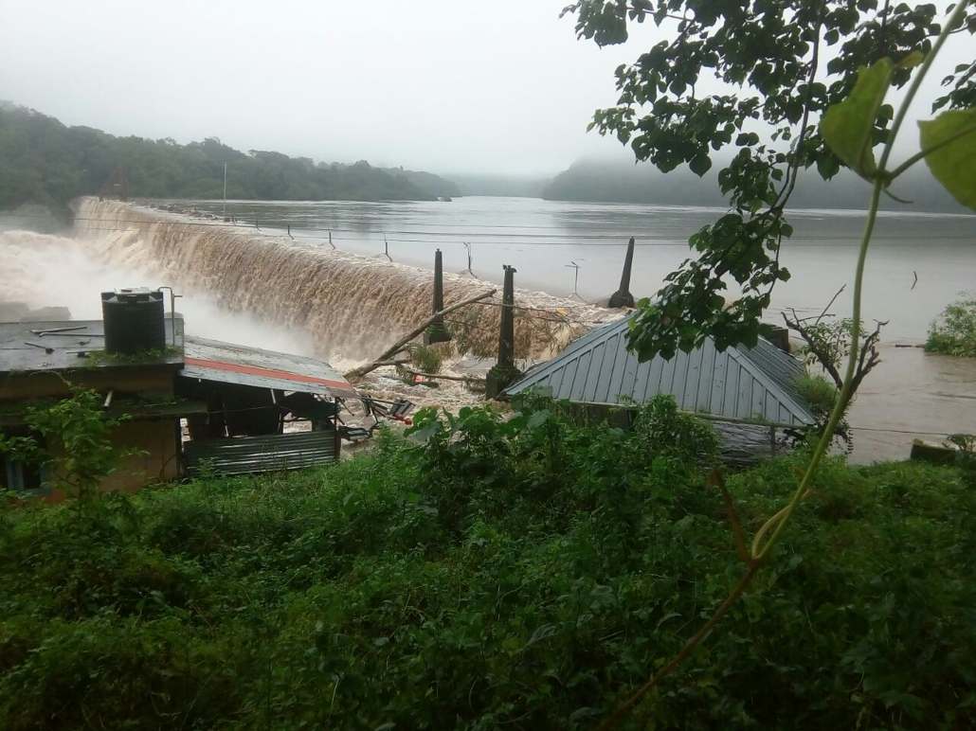
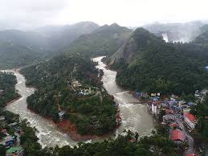

Slide 7
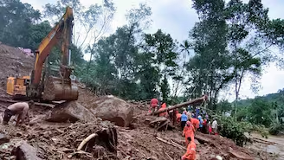
Causes of the Floods (Man-Made)
Urbanization
Unplanned urbanization has led to the encroachment of natural water bodies, reducing the drainage capacity of the land.
Deforestation
Loss of forest cover has diminished the land's ability to absorb water, increasing the risk of flooding.
Infrastructure Planning
Poor infrastructure planning and inadequate drainage systems have contributed to the flood's severity.

Slide 8
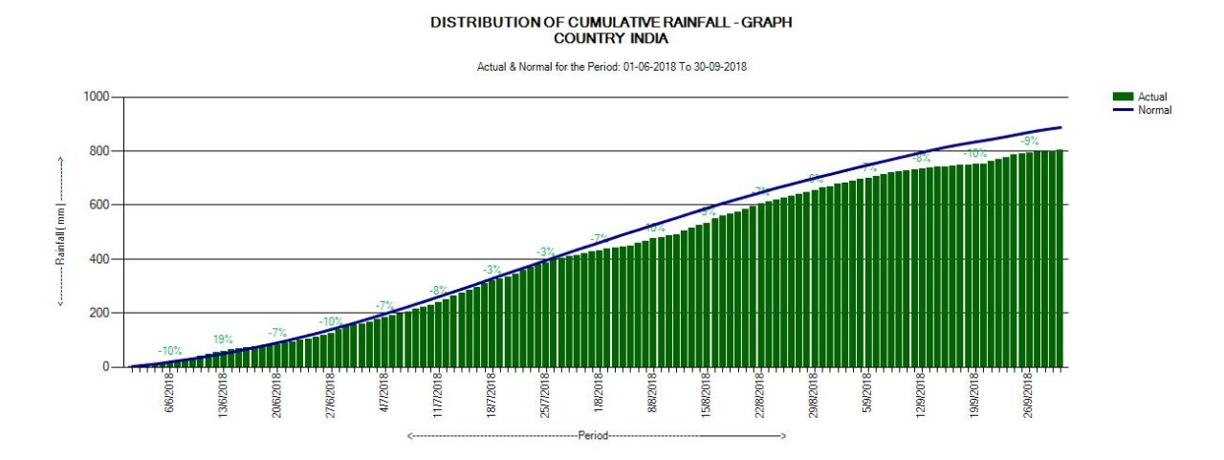
Rainfall Statistics
Year | Average Rainfall (mm) | Actual Rainfall (mm)
2018 | 2500 | 3500+

Slide 9
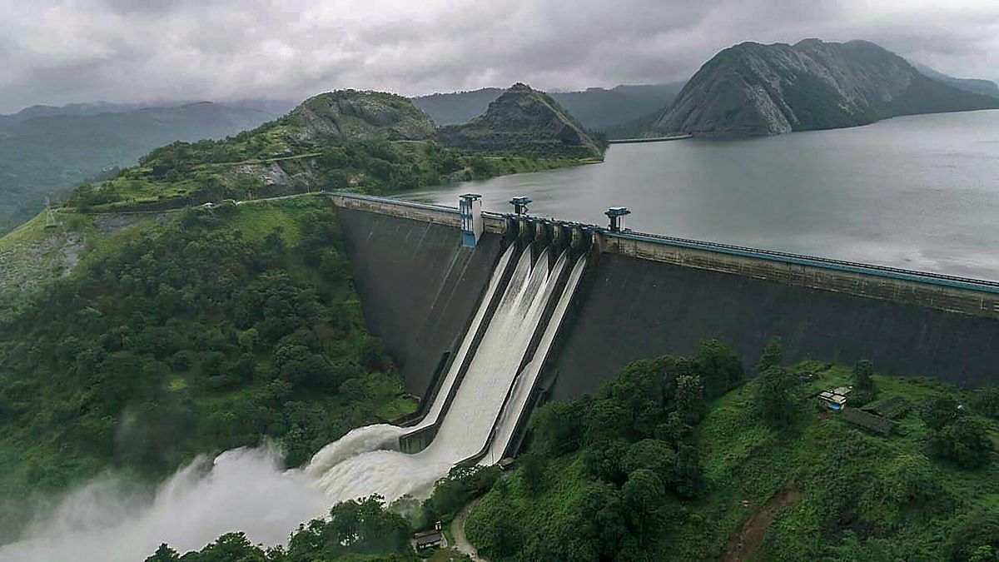
Dam Management Controversy
The Idukki Dam, Kerala’s largest arch dam, became a focal point of controversy during the floods. Despite receiving warnings of heavy rainfall and rising water levels, the dam's reservoir was allowed to fill up to almost full capacity. On August 8, 2018, for the first time in 26 years, all five shutters of the dam were opened to release water. This sudden release, combined with heavy rainfall, significantly worsened flooding in downstream areas such as Ernakulam and Alappuzha, submerging villages and causing widespread damage. Critics argued that if the dam had been managed more proactively, releasing water gradually in advance, the flood's severity could have been reduced.

Slide 10
Humanitarian crisis
The 2018 Kerala floods resulted in a major humanitarian crisis, displacing over 1.4 million people and leaving them in need of urgent aid. Thousands sought refuge in overcrowded relief camps, with many losing their homes, belongings, and livelihoods. The immediate challenges included providing food, clean water, sanitation, and healthcare to the flood victims. The risk of disease outbreaks, such as leptospirosis and cholera, loomed large due to the contaminated water and unsanitary conditions. The Kerala government, along with various NGOs and volunteers, coordinated relief efforts, but the scale of the disaster overwhelmed available resources. In addition to physical hardships, the emotional toll was immense, with many people suffering from trauma and anxiety after losing loved ones and their means of living.

Slide 11
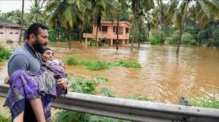
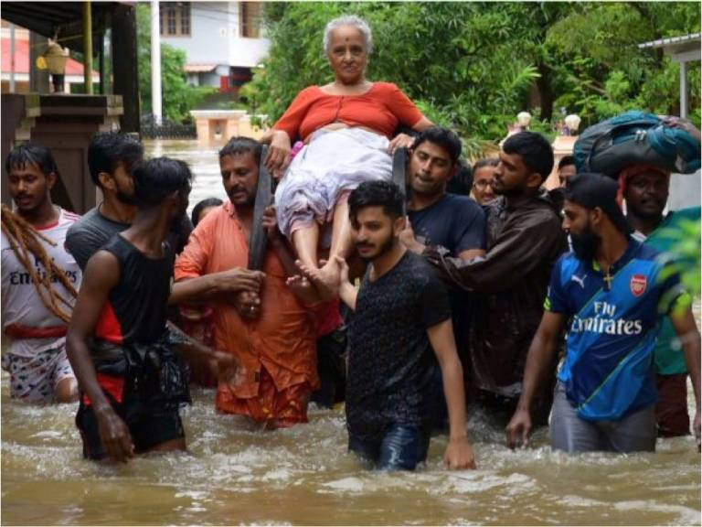
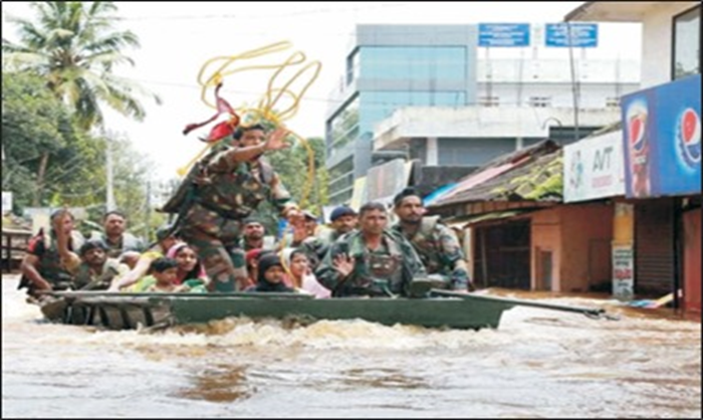
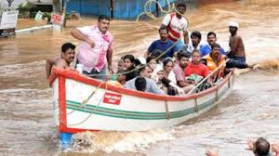

Slide 12
Rescue and Relief Efforts
Initial Response
The Indian government deployed the military, NDRF, SDMA and national disaster response forces to rescue and assist affected people.
NGOs and Volunteers
Numerous NGOs and volunteers from across the country and the world contributed to relief efforts.
Community Support
Local communities organized themselves to help each other, providing food, shelter, and medical aid.

Slide 13
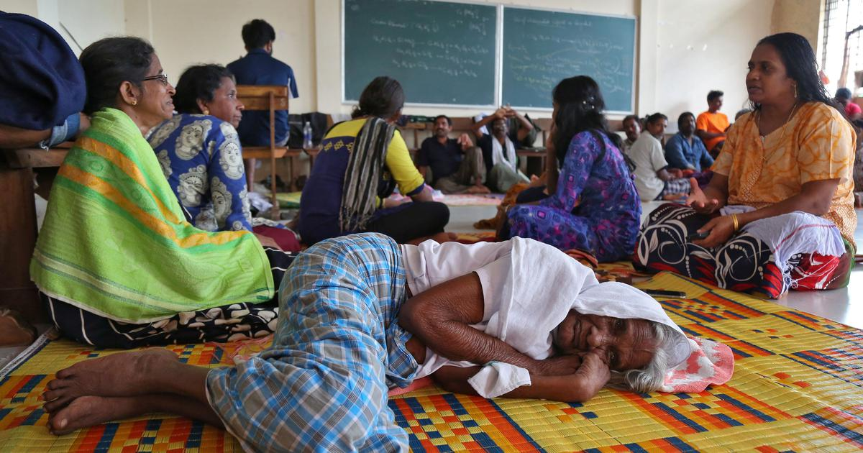
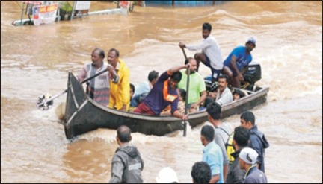
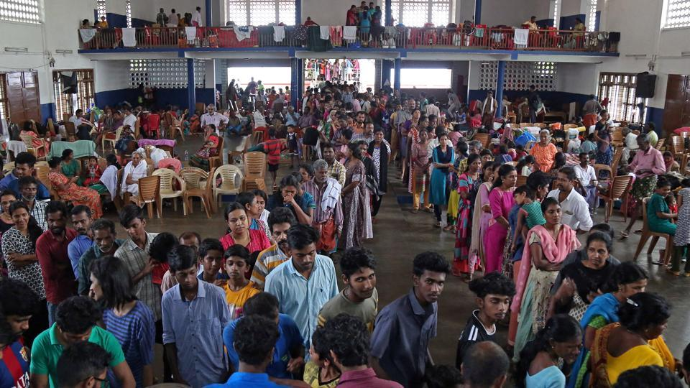
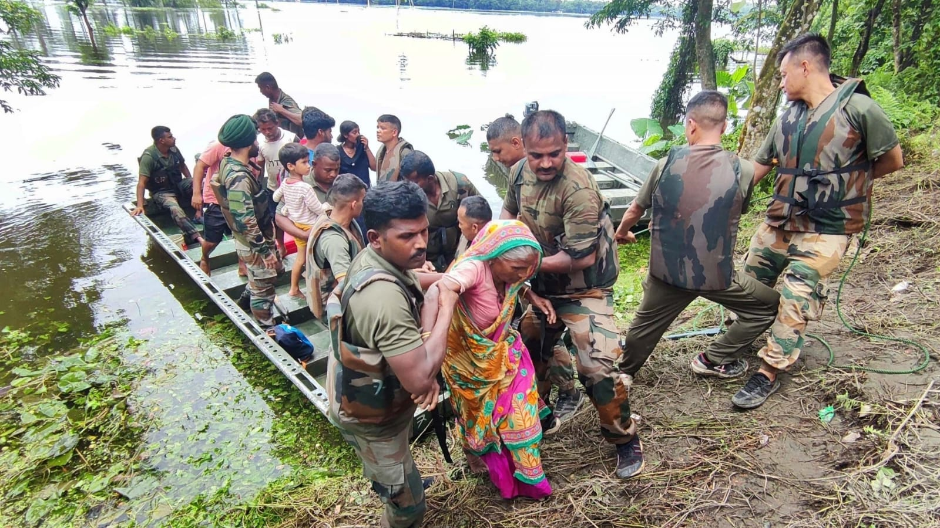
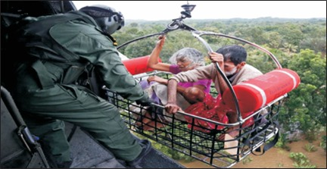
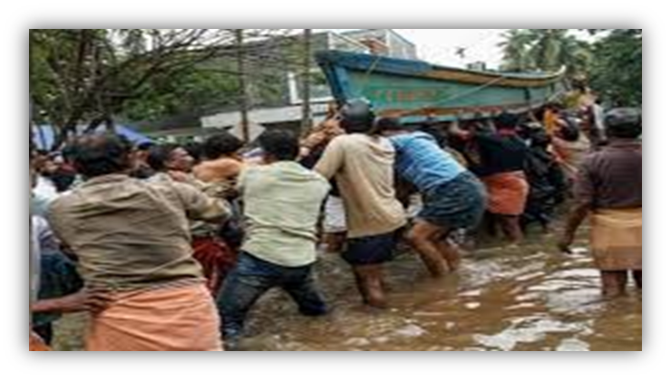
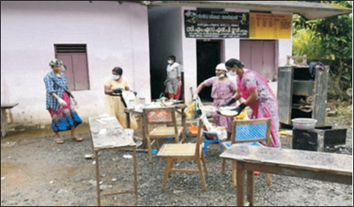

Slide 14
Impact on Floods
Human Loss
Property Loss
Affects the Major Roads Disruption of Air/Train/Bus services
Spread of Water-borne Communicable
Communication Breakdown
Electricity Supply Cut off
Economic and SocialDisruption
The tourist sectors got affected

Slide 15
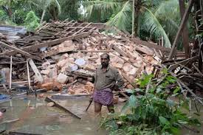
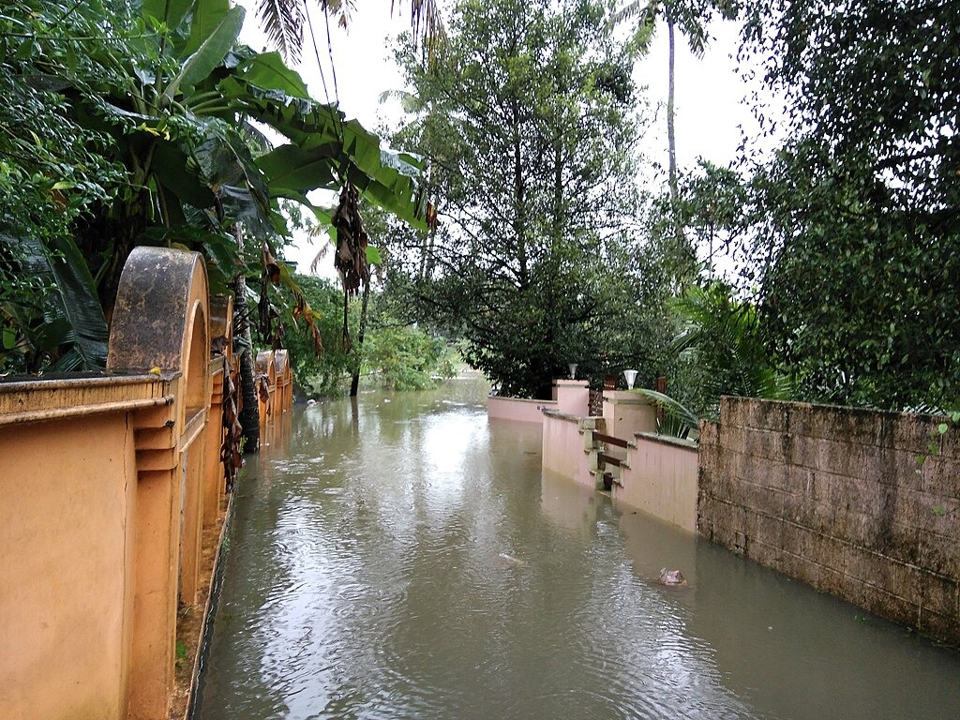
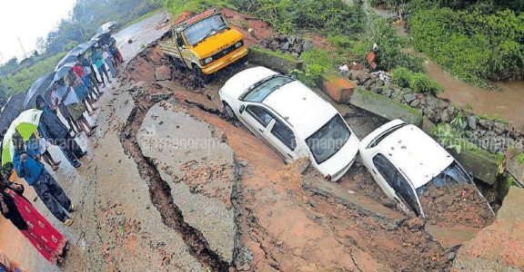
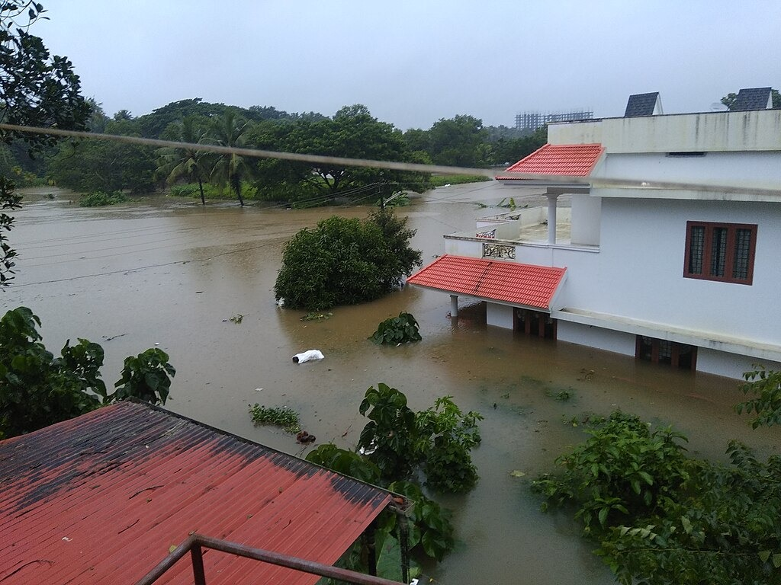
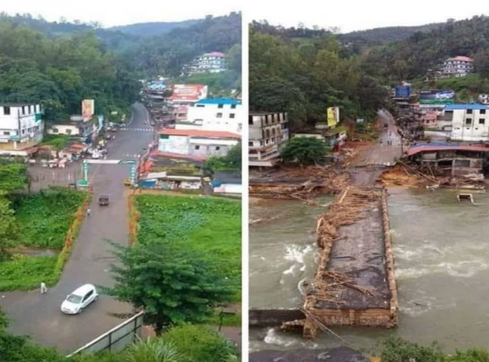
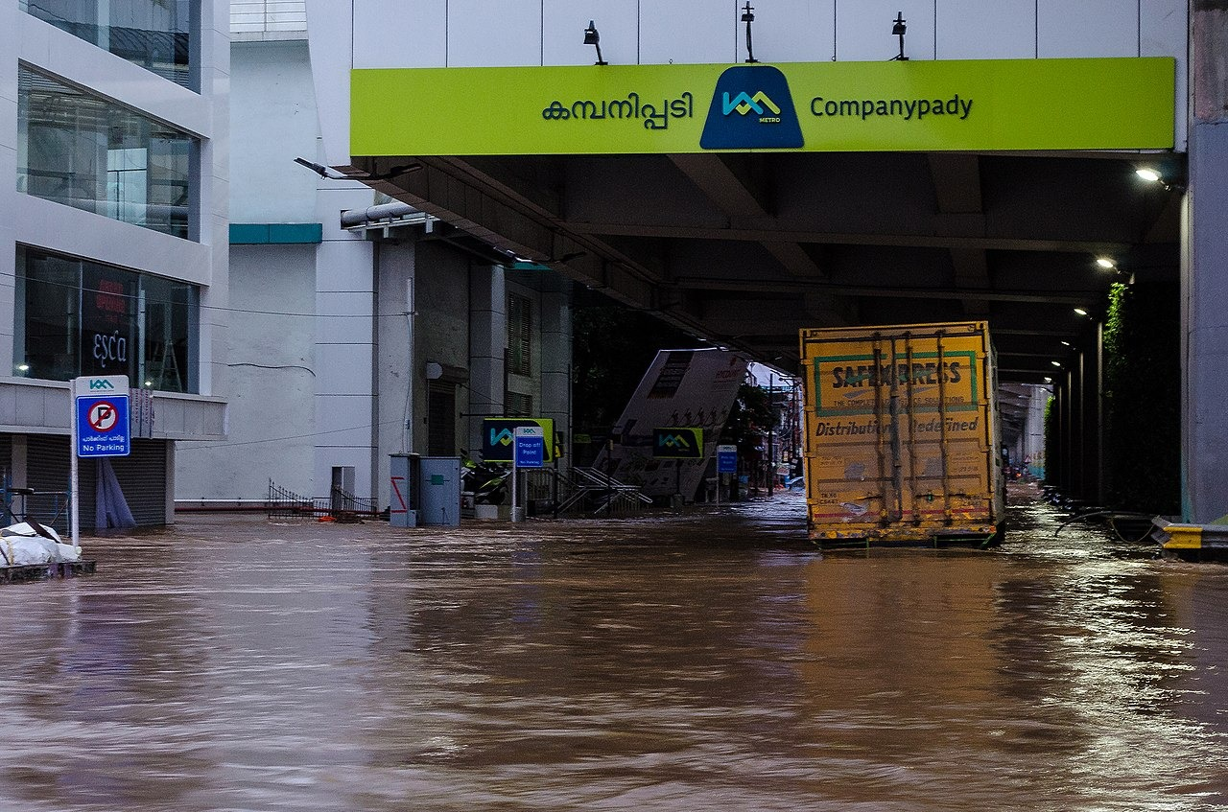

Slide 16
FUNDS & DONATION
Chief Minister disaster Relief funds
Prime Minister Narendra Modi
Celebraties from other industry
NRI people
Various political parties collected money
Central Government

Slide 17


Slide 18
CONCLUSION
The Kerala floods serve as a stark reminder of the devastating impact of natural disasters. The state's resilience, community spirit, and the collaborative efforts of various agencies were instrumental in mitigating the impact of the floods.
The lessons learned from this disaster will be crucial in shaping the state's future preparedness and response strategies to similar events.

Slide 19
Thank you :)

